Slide 1
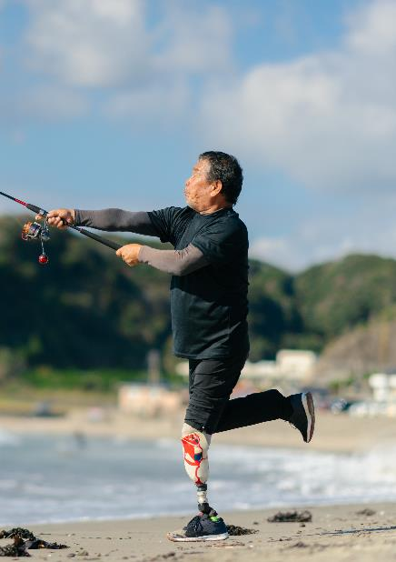
Beyond The Doctor’s Office:
The VA’s Whole Health approach to care and the Community Connection
Deborah Derflinger, BSN, RN, NBC-HWC
Jeremy Streem – Health and Wellness Coach
VA Northeast Ohio Healthcare System
Monday, April 1, 2024
Notes:
-Provide admin announcements to help people orient their VVC displays, locate chat box.
-Brief self-introduction

Slide 2
Click To Insert Title • Text boxes can move to accommodate content
Size 30pt, Calibri Bold, RGB 255,255,255
Objectives
During our time together you will:
Gain an understanding of the VA’s Whole Health approach to care, including Whole Health integration at all levels of care
Discuss the importance of Community connection in Whole Health ideology, and how the VA Whole Health system supports ‘Warm Handoff’ connections to community resources for Veterans
Learn how the Veteran Community Partnership Program benefits everyone involved
Notes:
-Provide overview
-Directly mention “proactive” and explain
-Explain SMART goals
-ASK AUDIENCE: “What does health and well-being mean to you?”

Slide 3
How is Whole Health Different?
Conventional Health Care
What’s the Matter With You?
(Sick Care/Disease Management)
Whole Health Care
What Matters To You?
(Integrative Care)
Notes:
-Tie back to proactive care.
-WH is complementary care services that are designed to support your traditional healthcare. It is not to replace your doctors.
-There is more to health than medicine and nutrition; and we focus on those other areas.

Slide 4

Whole Health
Be Alive. Be Well. Be Whole.
Notes:
Elements of Whole Health (RIGHT to LEFT)
It’s about more than your traditional healthcare (represented by the heart)
Fitness and exercise
Nutrition and fueling your body
Rest and rejuvenation
Mindful movement and awareness.
Find a better way to explain this
Whole Health is more than just the conventional medicine represented by the heart icon. Whole Health integrates all of these other areas into the concept of your total wellness.

Slide 5



Click To Insert Title • Text boxes can move to accommodate content • Size 30pt, Calibri Bold, RGB 255,255,255
  VHA MISSION
  Honor America’s Veterans by providing exceptional health care that improves their health and well-being.
  VA can and should lead the transformation of healthcare for our Veterans, and the Nation.
Notes:
-VA’s three departments
-VHA
-VBA
-NCA
“It’s important to start off with the VHA Mission to remind our Veteran participants and ourselves that this is the mission that we have accepted and will strive to fulfill. Emphasize that not only the Veterans’ health, but also their well-being is very important and that this will be a major focus during this session.”

Slide 6
Exceptional Care: Veteran-centered
Veteran
Getting to know YOU better
Focusing on YOUR goals
What matters most to YOU
Supporting YOUR well-being

Slide 7
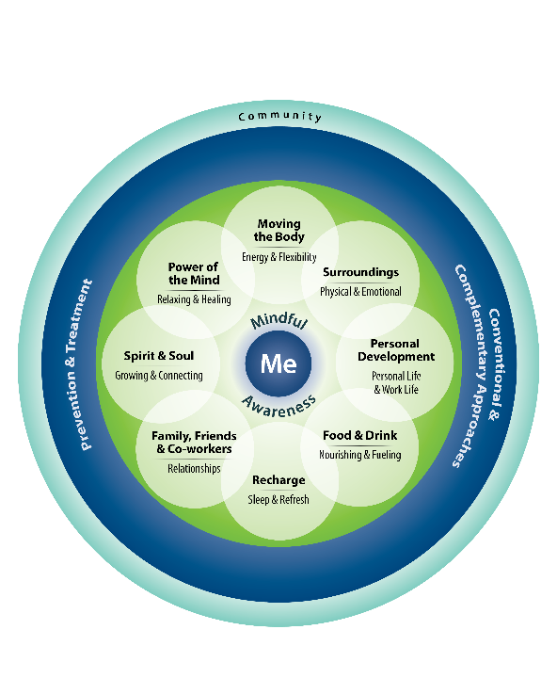
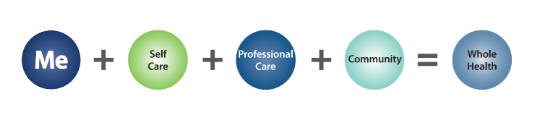
• Media/Video
Notes:
Touch back on Health and Well-being: Refer participants to their handout (PHI) of the “Circle of Health”
At the center of the circle is “Me”--- who they are as a person, and it expands outward to encompass mindful awareness, the eight areas of self-care, professional care, and the community. Continue discussion each component listed on the next slide using the script.
“Anywhere that you’re ready to take charge of your life is going to fall into at least one of these areas”
Making an improvement in one area can also have an impact on other areas.
ADDRESS THESE AREAS WITHOUT JUDGMENT, BUT WITH PURPOSE
Can we do a better job of tying things back and showing the relatability of all of these? If you talk about volunteering and philanthropy in ‘Personal Development’, and then you reference ‘greater than yourself’ in ‘Spirit and Soul’, you should tie that back.

Slide 8
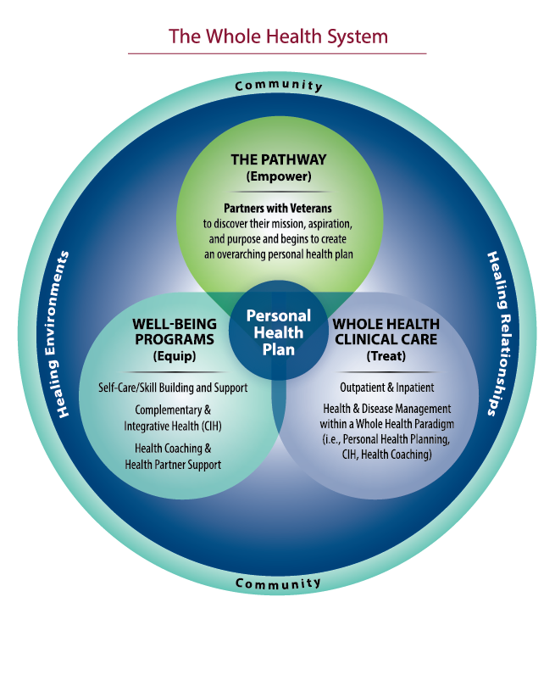
The Whole Health Pathway
  Whole Health
  is an approach
  to health care that
  empowers and equips
  Veterans to take charge
  of their health and well-being, receive
  treatment as necessary,
  and live your life to the fullest.
Notes:
Read the definition of Whole Health and ask what participants think about the emphasis on empowering and equipping people to take charge of their well-being.
Use this slide as a segue into the discussion of different aspects of Whole Health on the handout – Whole Health: It Starts with Me.
-The following two slides dive deeper into the Well-Being Programs.

Slide 9
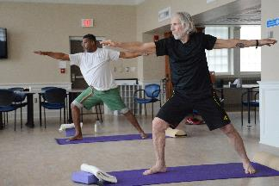
Well-Being Programs
Self-Care/Skill Building & Support
Food as Medicine
Healthy Teaching Kitchen
MOVE! Lifestyle Intervention
iRest Yoga Nidra Meditation
Reiki Meditation
Tai Chi Easy
Yoga – Mindful (mat) & Gentle (chair)
Laughter for Wellness
Expressive Arts: Music Matters, Strings & Stripes, Creative Writing
Aromatherapy
Music Therapy & Art Therapy
Spirit & Soul
Nicotine Cessation
Chronic Pain Shared Medical Appointment
Stress Management Shared Medical Appointment
Taking Charge of My Life and Health
Whole Health THRIVE

Slide 10
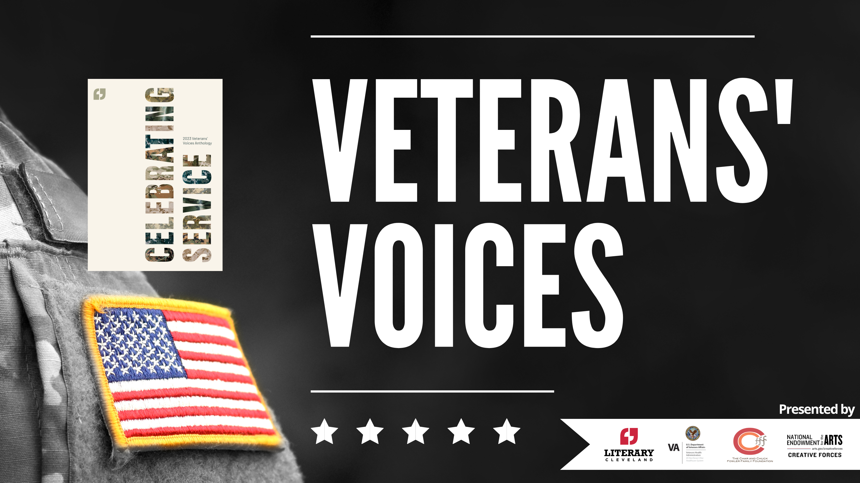
Community pARTnership

Slide 11

Notes:
The importance of community
Whole Health System: Community Partnerships - YouTube

Slide 12
What is a VCP?
Veteran Community Partnerships (VCP) are formalized partnerships through which local VA facilities connect with state and local community service agencies in an effort to:
  Enhance and improve access to and quality of care
  Promote seamless transitions
  Educate community agencies & VA providers
  Support caregivers
  Develop and foster strong relationships between VA and community agencies and providers

Slide 13
Who is Involved?
VA Medical Center Partners:
  Hospice and Palliative Care
  VA Voluntary Service
  OIF/OEF program
  Social Work Service
  Nursing Service/Community Health
  Mental Health Service
  Geriatrics and Extended Care
  Office of Public Affairs
  Homelessness
  Veteran Experience Office
Community Partners:
  Veterans
  Veterans Services Organizations
  Community, County, and State Human Services agencies
  Aging network
  Caregivers/Respite organizations
  Academic institutions
  Faith-based organizations
  Non-profits
  Charitable & Philanthropic organizations
  Hospice organizations
  Home care agencies
  Disability groups

Slide 14
Activities of VCPs
Conduct assessments to determine the unique needs of Veterans within communities
Exchange information between VA and community agencies in an effort to keep both informed of local and VA resources, strengths, and potential growth areas
Educate community agencies about specific veteran-related issues and benefits
Conduct community outreach educational programs for Veterans groups/community agencies to provide information on the VA continuum of care, available resources, and options
Hold local/regional/statewide educational events for both community and VA stakeholders to provide information on the continuum of care options and VA healthcare system
Create/disseminate educational tools that partners can access for the most current and complete information on resources for veterans, in VA and in the community…And more!

Slide 15

Better Together:
The Importance of Community
Humans are social creatures
Community is critical to our health & wellbeing
Decreased isolation & loneliness
A sense of Purpose
Belonging
Trust & psychological safety
Feel valued & appreciated
Resilience

Slide 16

How We Can Work Together
Whole Health representation during your sessions
Pre and post surveys to gather feedback
How will Veterans register for your offerings?
How does your offering connect to the Circle of Health?

Slide 17
To Learn More
www.va.gov/healthpartnerships/vcpreporting.asp
va.gov/wholehealth
Deborah.Derflinger@va.gov
Jeremy.Streem@va.gov

Slide 18
Questions?

