Slide 1
Rick ford, lisw-s chris Bivens, RN, BSN
QRT AND OVERDOSE PREVENTION IN ASHLAND COUNTY: r.s.v.p. Conference 3-30-22

Slide 2

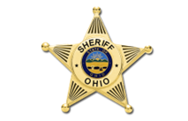
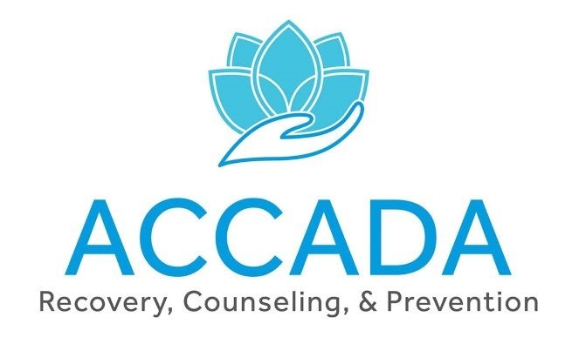
What is qrt?
QRT stands for “Quick Response Team”. The team consists of local law enforcement from Ashland Police and Sheriff’s Departments and ACCADA (treatment professional)

Slide 3
What is the purpose of qrt?
To eliminate overdoses within our community
The goal of contact with an overdose survivor is to provide resource information, support and encouragement to engage or re-engage in treatment services.
Home Visits to occur within 72 hours post-overdose
To improve and enhance community relations with law enforcement

Slide 4

Project DAWN
What is it and what can we do to help our community

Slide 5
What is project DAWN?
Project DAWN (Deaths Avoided With Naloxone) is a network of opioid overdose education and naloxone distribution programs (OENDP) coordinated by the Ohio Department of Health. Visit the What is Naloxone page for more information on the overdose reversal medication.
Project DAWN is named in memory of Leslie Dawn Cooper, who struggled with substance use disorder for many years before dying from a witnessed opioid overdose on Oct. 3, 2009. The first Project DAWN site was established in Leslie’s hometown of Portsmouth, Ohio, in 2012. Since then, Project DAWN has expanded to a collective of more than 280 naloxone distribution sites that cover around 72 of Ohio’s 88 counties

Slide 6
The Project DAWN Network
As of September 2021, there are 102 Project DAWN programs registered in Ohio. Project DAWN programs distribute naloxone and provide training at one or various Project DAWN sites, or locations, to prevent opioid overdose and promote harm reduction. Many Project DAWN programs operate multiple sites, usually with partnering agencies. Program partnerships and settings include:
Health departments.
Syringe service programs (SSPs).
Community grassroots organizations.
Emergency departments.
Correctional facilities.
Leave-behind programs with emergency medical services (EMS).
Online/mail-order services.
Street outreach.

Slide 7
Risk factors for Opioid overdose
Changes in tolerance from not using or using less. This happens after being in jail, detox, or following a period of abstinence.
Changes in quality or purity of heroin and fentanyl.
Mixing opioids with alcohol or benzodiazepines (benzos). Benzos include Klonopin, Xanax, Ativan, Valium, Librium, and others.
Mixing opioids with stimulants, such as: crack/cocaine, meth, speed, and others.
Having poor nutrition, a weak immune system, heart problems, or other health issues (i.e.HIV, Hepatitis C, unhealthy lungs from smoking or liver damage from drinking).
Surviving a past overdose.

Slide 8
Strategies to prevent opioid overdose

Slide 9
Targeted Naloxone distribution
Naloxone – a non-addictive, life-saving drug that can reverse the effects of an opioid overdose when administered in time. Targeted naloxone distribution programs seek to train and equip individuals who are most likely to encounter or witness an overdose—especially people who use drugs and first responders— with naloxone kits, which they can use in an emergency to save a life.

Slide 10
Medication-Assisted Treatment (MAT) and Medication for Opioid Use Disorder (MOUD)
MAT is a proven treatment for opioid use disorder. The backbone of this treatment is FDA approved medications. Methadone and buprenorphine, activate opioid receptors in the brain, preventing painful opioid withdrawal symptoms without causing euphoria; naltrexone blocks the effects of opioids.

Slide 11
Academic detailing
Academic detailing consists of structured visits to healthcare providers by trained professionals. They provide tailored training and technical assistance, helping healthcare providers use best practices.

Slide 12
911 good Samaritan laws
The scope of 911 Good Samaritan Laws varies across U.S. states, but each is written with the goal of reducing barriers to calling 911 in the event of an overdose. This type of legislation may provide overdose victims and/or overdose bystanders with limited immunity from drug-related criminal charges and other criminal or judicial consequences that may otherwise result from calling first responders to the scene.

Slide 13
Syringe service programs
Syringe services programs (SSPs) are community-based prevention programs that can provide a range of services, including linkage to substance use disorder treatment; access to and disposal of sterile syringes and injection equipment; testing; treatment for infectious diseases; and linkage to medical, mental health, and social services

Slide 14
Signs and symptoms of opioid overdose
Marked confusion, delirium, or acting drunk
Frequent vomiting
Pinpoint pupils
Extreme sleepiness, or the inability to wake up
Intermittent loss of consciousness
Breathing problems, including slowed or irregular breathing
Respiratory arrest (absence of breathing)
Cold, clammy skin, or bluish skin around the lips or under the fingernails

Slide 15
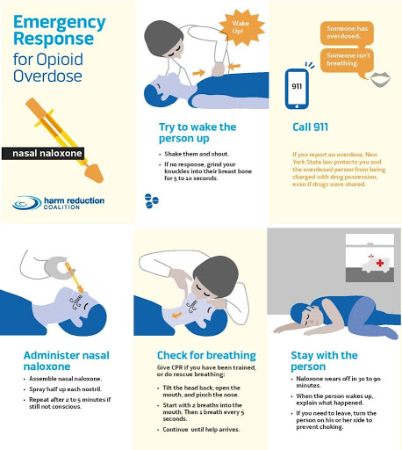
Responding to an overdose
STEP 1. Stimulate them awake by yelling their name and administering a hard sternum rub to the chest plate.
STEP 2. If you have naloxone/Narcan, use it. Administer one dose every two minutes.
Injectable: Draw up entire vial and inject into thigh muscle (must be muscle’ed to work)
Nasal: Stick the device all the way up one nostril and click the plunger, make sure the device is inserted fully (medication will absorb through the sinuses)
STEP 3. Call 911, explain someone is not responsive and not breathing
STEP 4. Provide rescue breathing
Get the person on their back, tip their head back to straighten the airway, pinch their nose, put your mouth over theirs and form a seal, one breath every five seconds
STEP 5. When the person starts to breathe regularly on their own, roll them into a recovery position on their side
STEP 6. Be gentle with them and yourself afterwards!

Slide 16
How to administer Naloxone

Slide 17
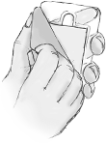
Peel
Peel back the package to remove the device. Hold the device with your thumb on the bottom of the red plunger and 2 fingers on the nozzle

Slide 18
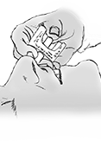
Place
Place and hold the tip of the nozzle in either nostril until your fingers touch the bottom of the patient's nose.

Slide 19
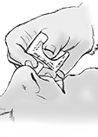
Press
Press the red plunger firmly to release the dose into the patient's nose.

Slide 20
What is naloxone
Naloxone is a medication approved by the Food and Drug Administration (FDA) designed to rapidly reverse opioid overdose. It is an opioid antagonist—meaning that it binds to opioid receptors and can reverse and block the effects of other opioids, such as such as heroin, morphine, and oxycodone. Administered when a patient is showing signs of opioid overdose, naloxone is a temporary treatment and its effects do not last long. Therefore, it is critical to obtain medical intervention as soon as possible after administering/receiving naloxone.
The medication can be given by intranasal spray (into the nose), intramuscular (into the muscle), subcutaneous (under the skin), or intravenous injection
Side Effects of Naloxone
Patients who experience an allergic reaction from naloxone, such as hives or swelling in the face, lips, or throat, should seek medical help immediately. They should not drive or perform other potentially unsafe tasks.
Use of naloxone causes symptoms of opioid withdrawal. Medical assistance must be obtained as soon as possible after administering/receiving naloxone.
Opioid withdrawal symptoms include:
Feeling nervous, restless, or irritable
Body aches
Dizziness or weakness
Diarrhea, stomach pain, or nausea
Fever, chills, or goose bumps
Sneezing or runny nose in the absence of a cold

Slide 21
Naloxone storage and expiration
Naloxone storage
Naloxone should be stored between 68°F and 77°F (previously 59°F to 77°F )
Temperature excursions are permitted between 41°F and 104°F (previously 59°F to 104°F)
Naloxone should be stored in a locked box or cabinet
Naloxone expiration
The expiration date for Naloxone can be found on the top of the box

Slide 22
Reporting reversals and obtaining replacement doses
Reporting Reversals
Overdose reversals should be reported to first responders
Overdose reversals should also be reported to LHD
Obtaining replacement doses
Replacement doses may be obtained at The Ashland County Health Department

Slide 23
Substance abuse treatment options in Ashland
Ashland County Council on Alcoholism and Drug Abuse
NA and AA
AL-ANON

Slide 24
Chris Bivens
Ashland County Health Department
1763 state route 60
Ashland, Ohio, 44805
419-282-4232 cbivens@health-ashlandcounty-oh.gov
Thank you for your time!

