Slide 1




THE QUIET POWER OF EVERYDAY CARE

Slide 2


Slide 3


Slide 4


Slide 5


Slide 6


Slide 7


Slide 8


Slide 9


Slide 10


Slide 11


Slide 12


Slide 13


Slide 14
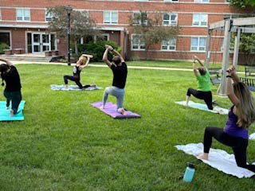

Slide 15


Slide 16


Slide 17


Slide 18


Slide 19
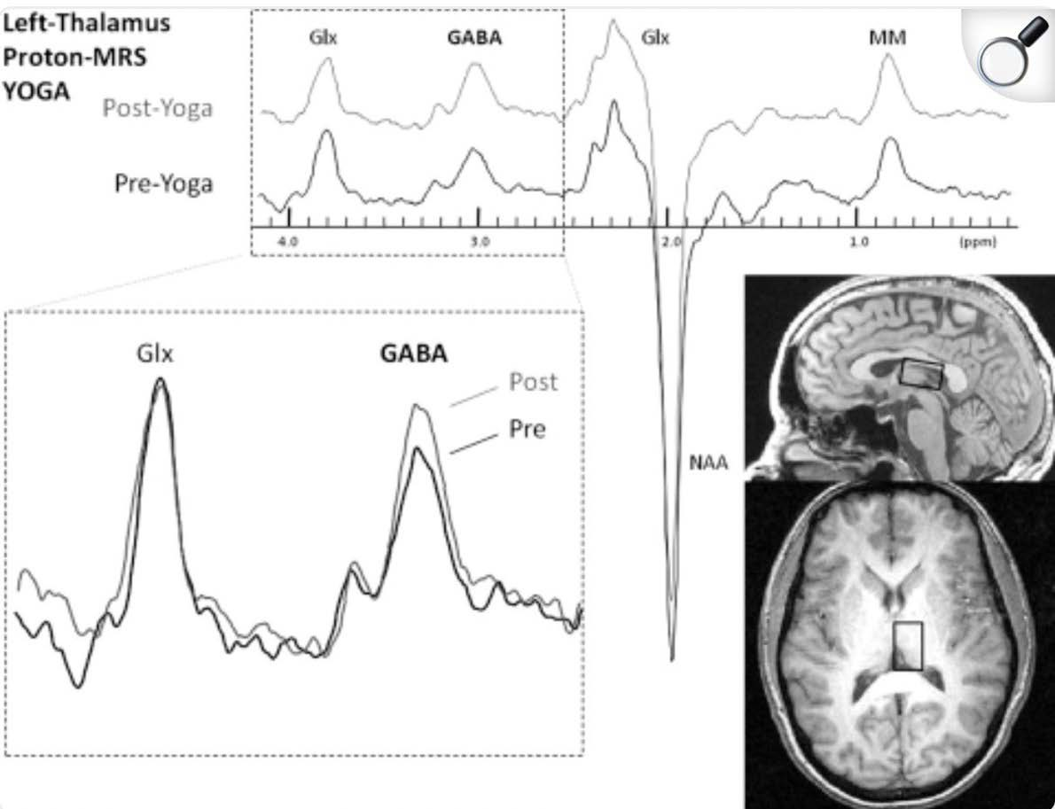
Researchers Identify Link between
Decreased Depressive Symptoms,
Yoga and the Neurotransmitter GABA

Slide 20

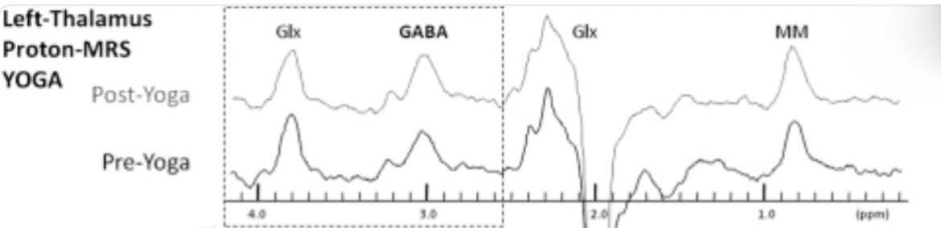

Slide 21


Slide 22


Slide 23



THANK YOU FOR COMING

