Slide 1

The Power of the Gut – A look at what we eat, the gut microbiome and our health

Slide 2
What is the Gut Microbiome?
100s of bacteria, viruses, and fungi types that live in the GI tract
Some of the bacteria that live in the gut include:
Escherichia coli (E. Coli)
Lactobacillus
Bifidobacterium
Streptococcus
Kleibsiella

Slide 3
What influences the makeup of the gut microbiome?
How you are born
Environment
Antibiotic/medication use
Of course – what you eat!

Slide 4
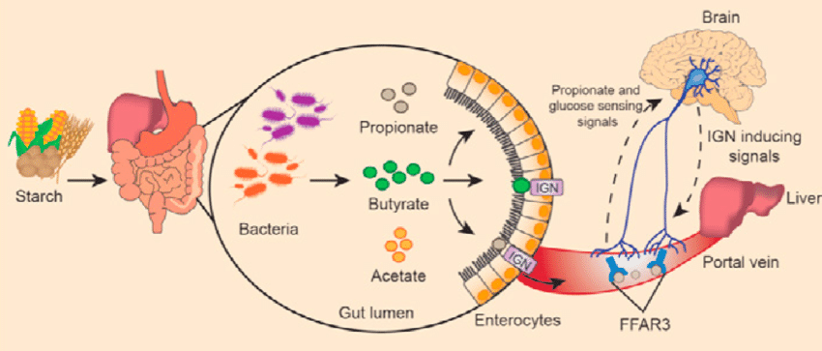
What is Job of Gut Bacteria?

Slide 5
Loh, JS et. al. Microbiota-gut-brain axis and its therapeutic applications in neurodegenerative diseases. Nature. (2024)

Slide 6
Effects of a Healthy Microbiome
Increase energy expenditure (burn more kcals)
Decrease food intake (don’t feel so hungry)
Decrease blood lipids (the ones that lead to cardiovascular disease)
Improve circadian rhythm (sleep)
Help to manage anxiety and depression
Decreases inflammation

Slide 7
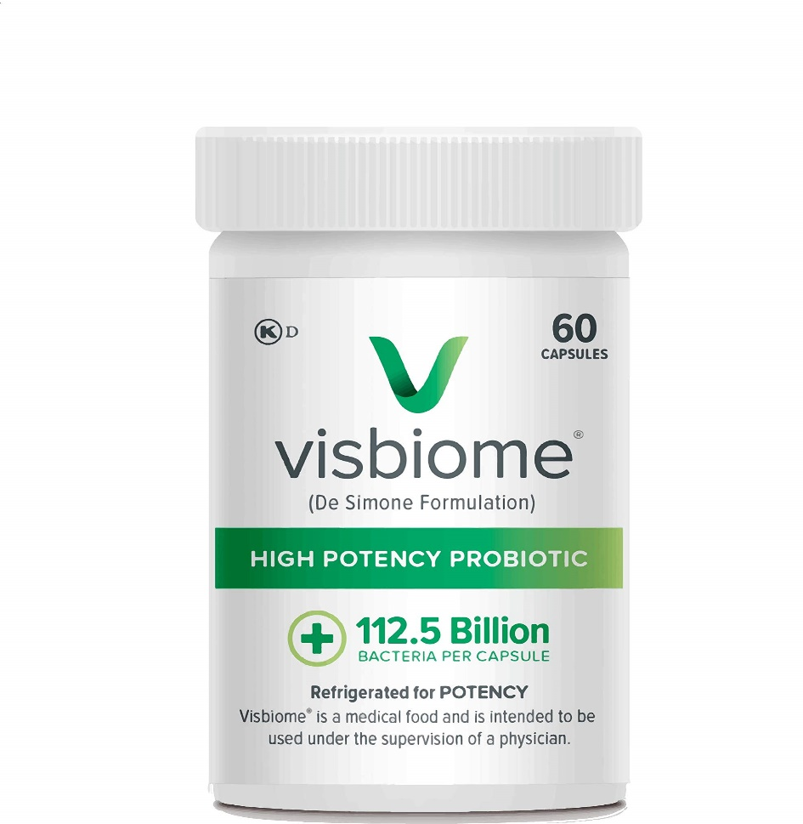
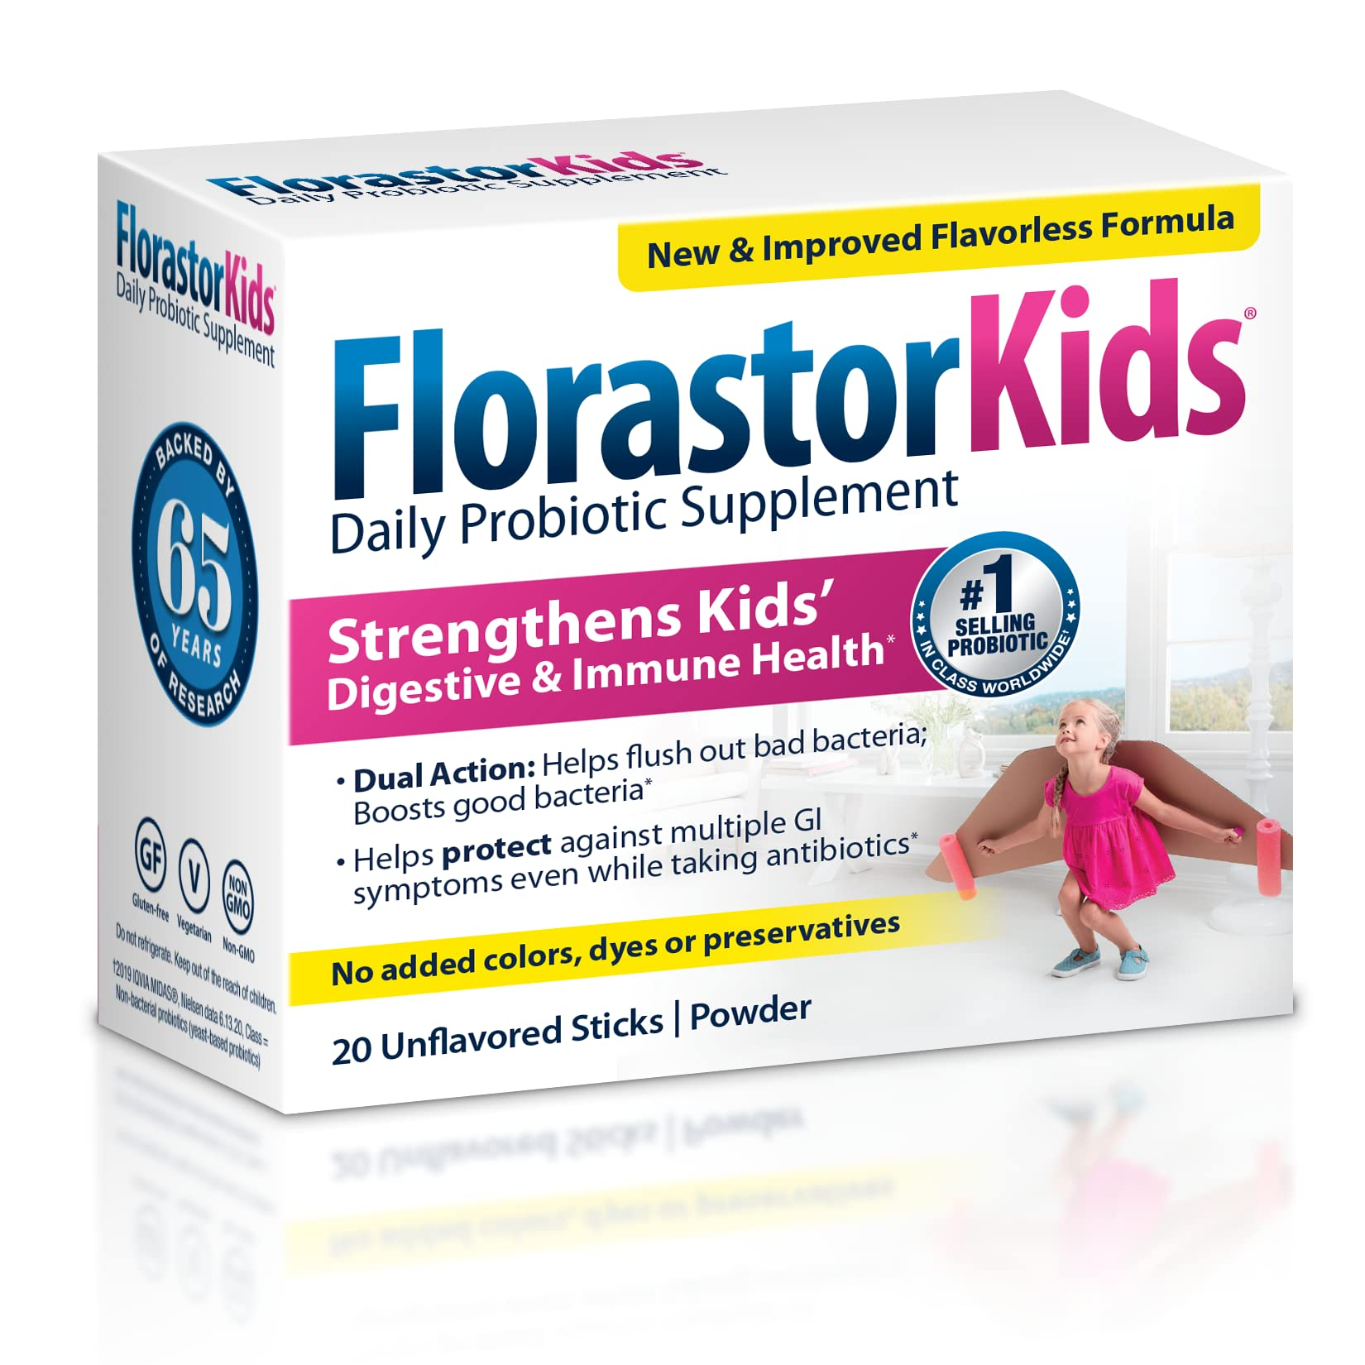
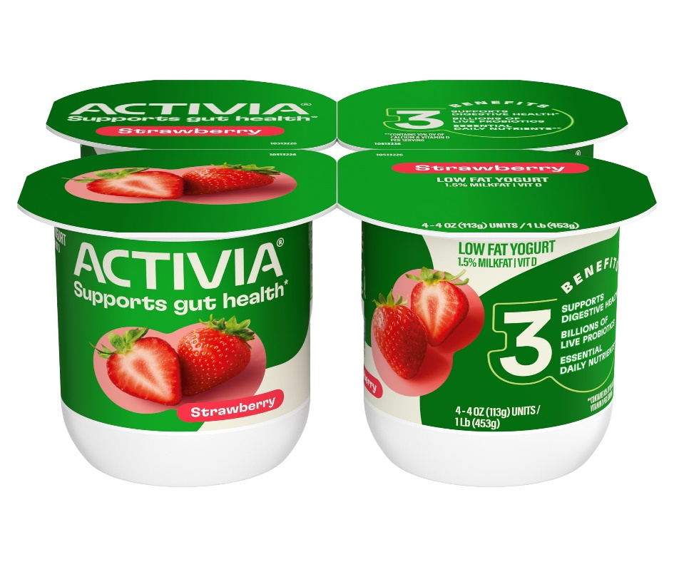
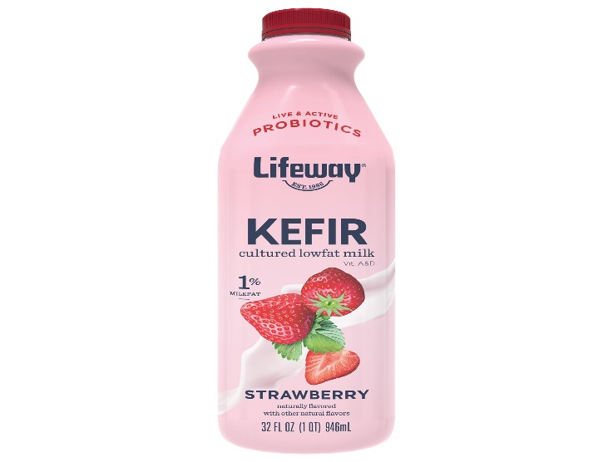
Probiotics
These are nutrition supplements that contain live bacteria

Slide 8
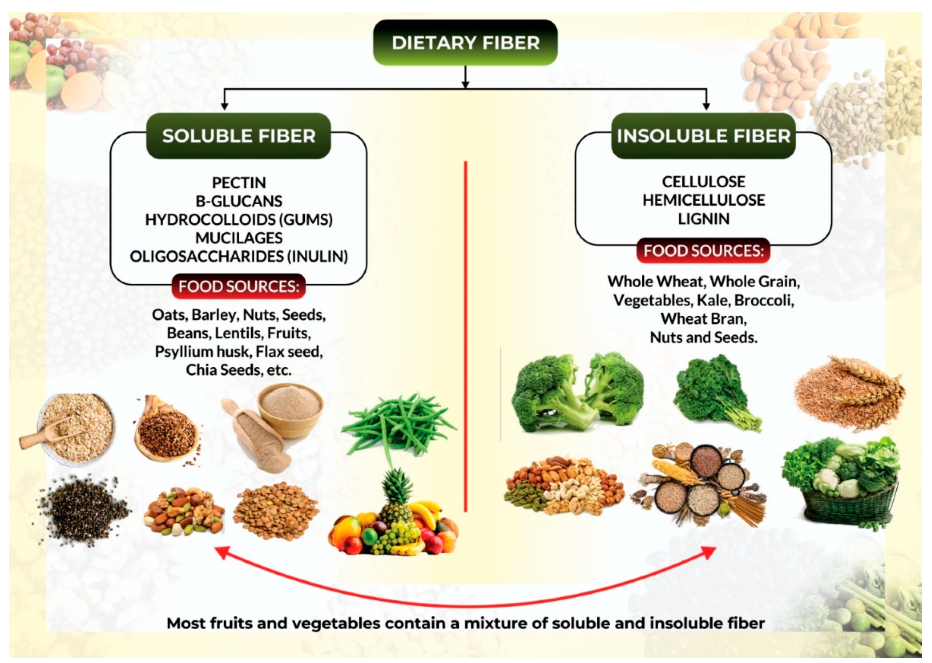
Prebiotics

Slide 9
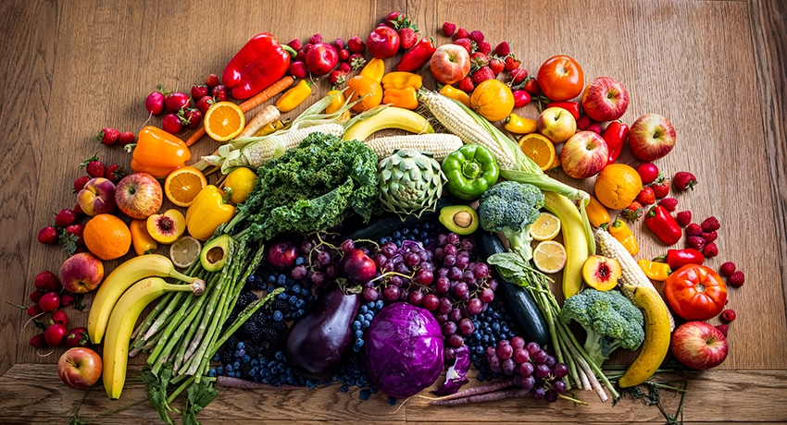
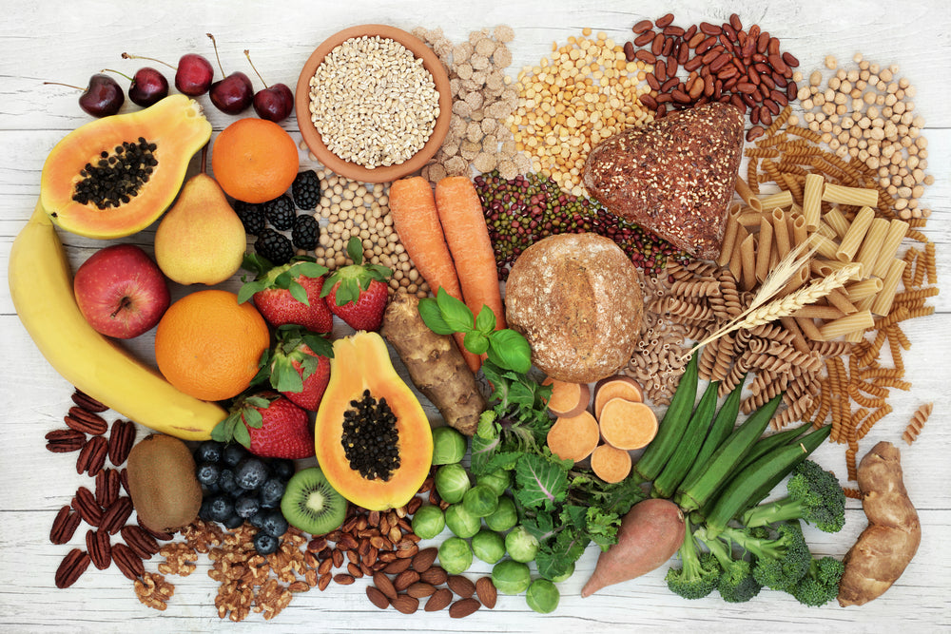
What to eat for a healthy gut

Slide 10
Let’s discuss some real patients!

Slide 11
Thank you for being a great audience today!

