Slide 1
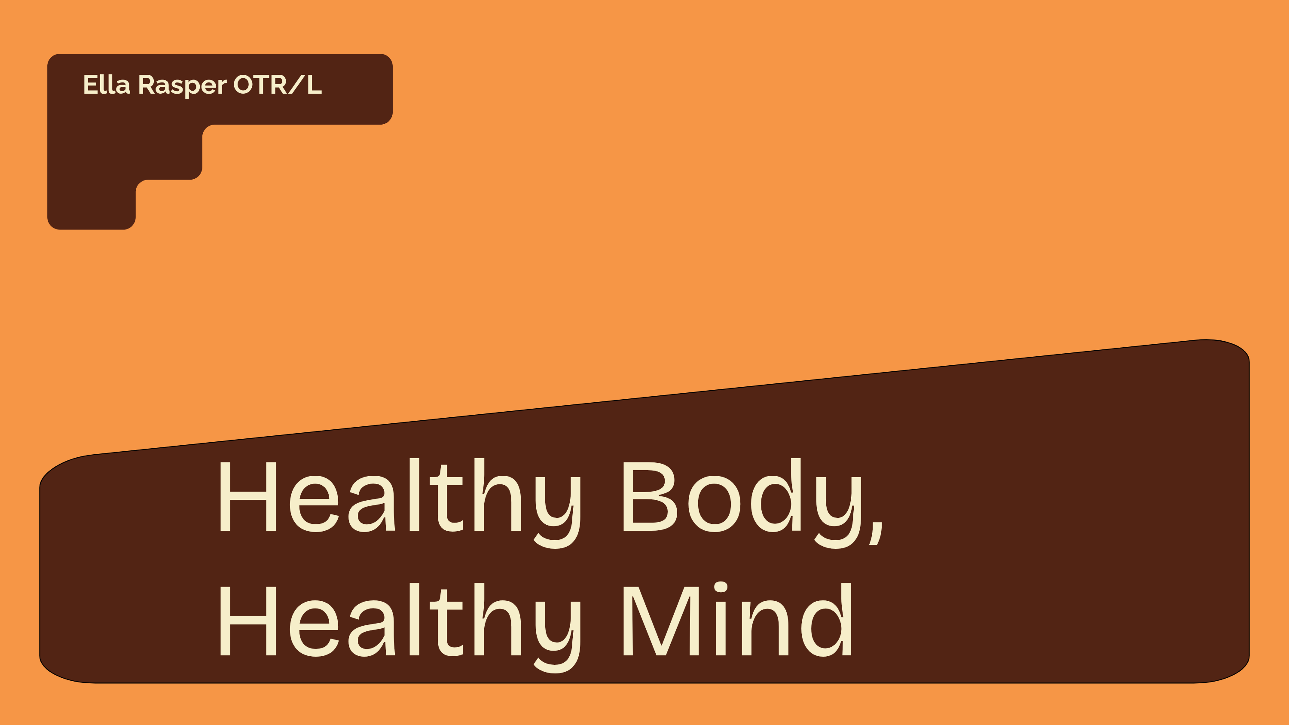

Slide 2


Ella Rasper OTR L
Occupational therapist at University Hospitals in Ashland, Ohio

Slide 3

Master's Degree in Occupational Therapy, Gannon University (2024)
Employed with University Hospitals since 2024
Adult populations: orthopedic and neurological conditions
Pediatric populations: developmental and sensory deficits

Slide 4
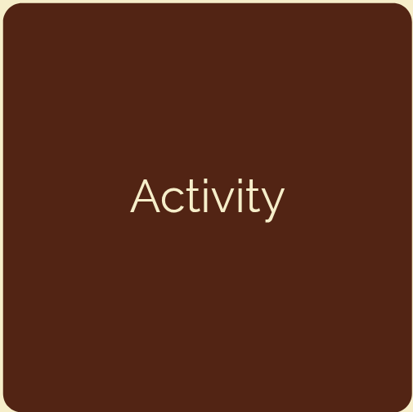

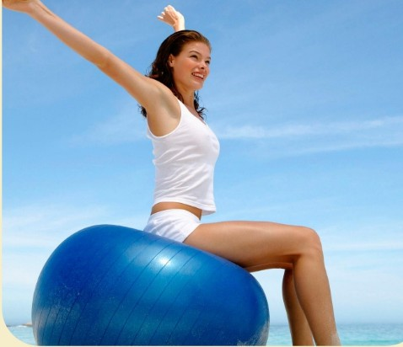


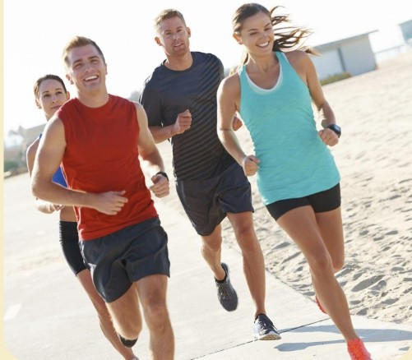
Overview
Different types of exerci^{I} se
Activity
How exercise impacts mental health
How to get started

Slide 5
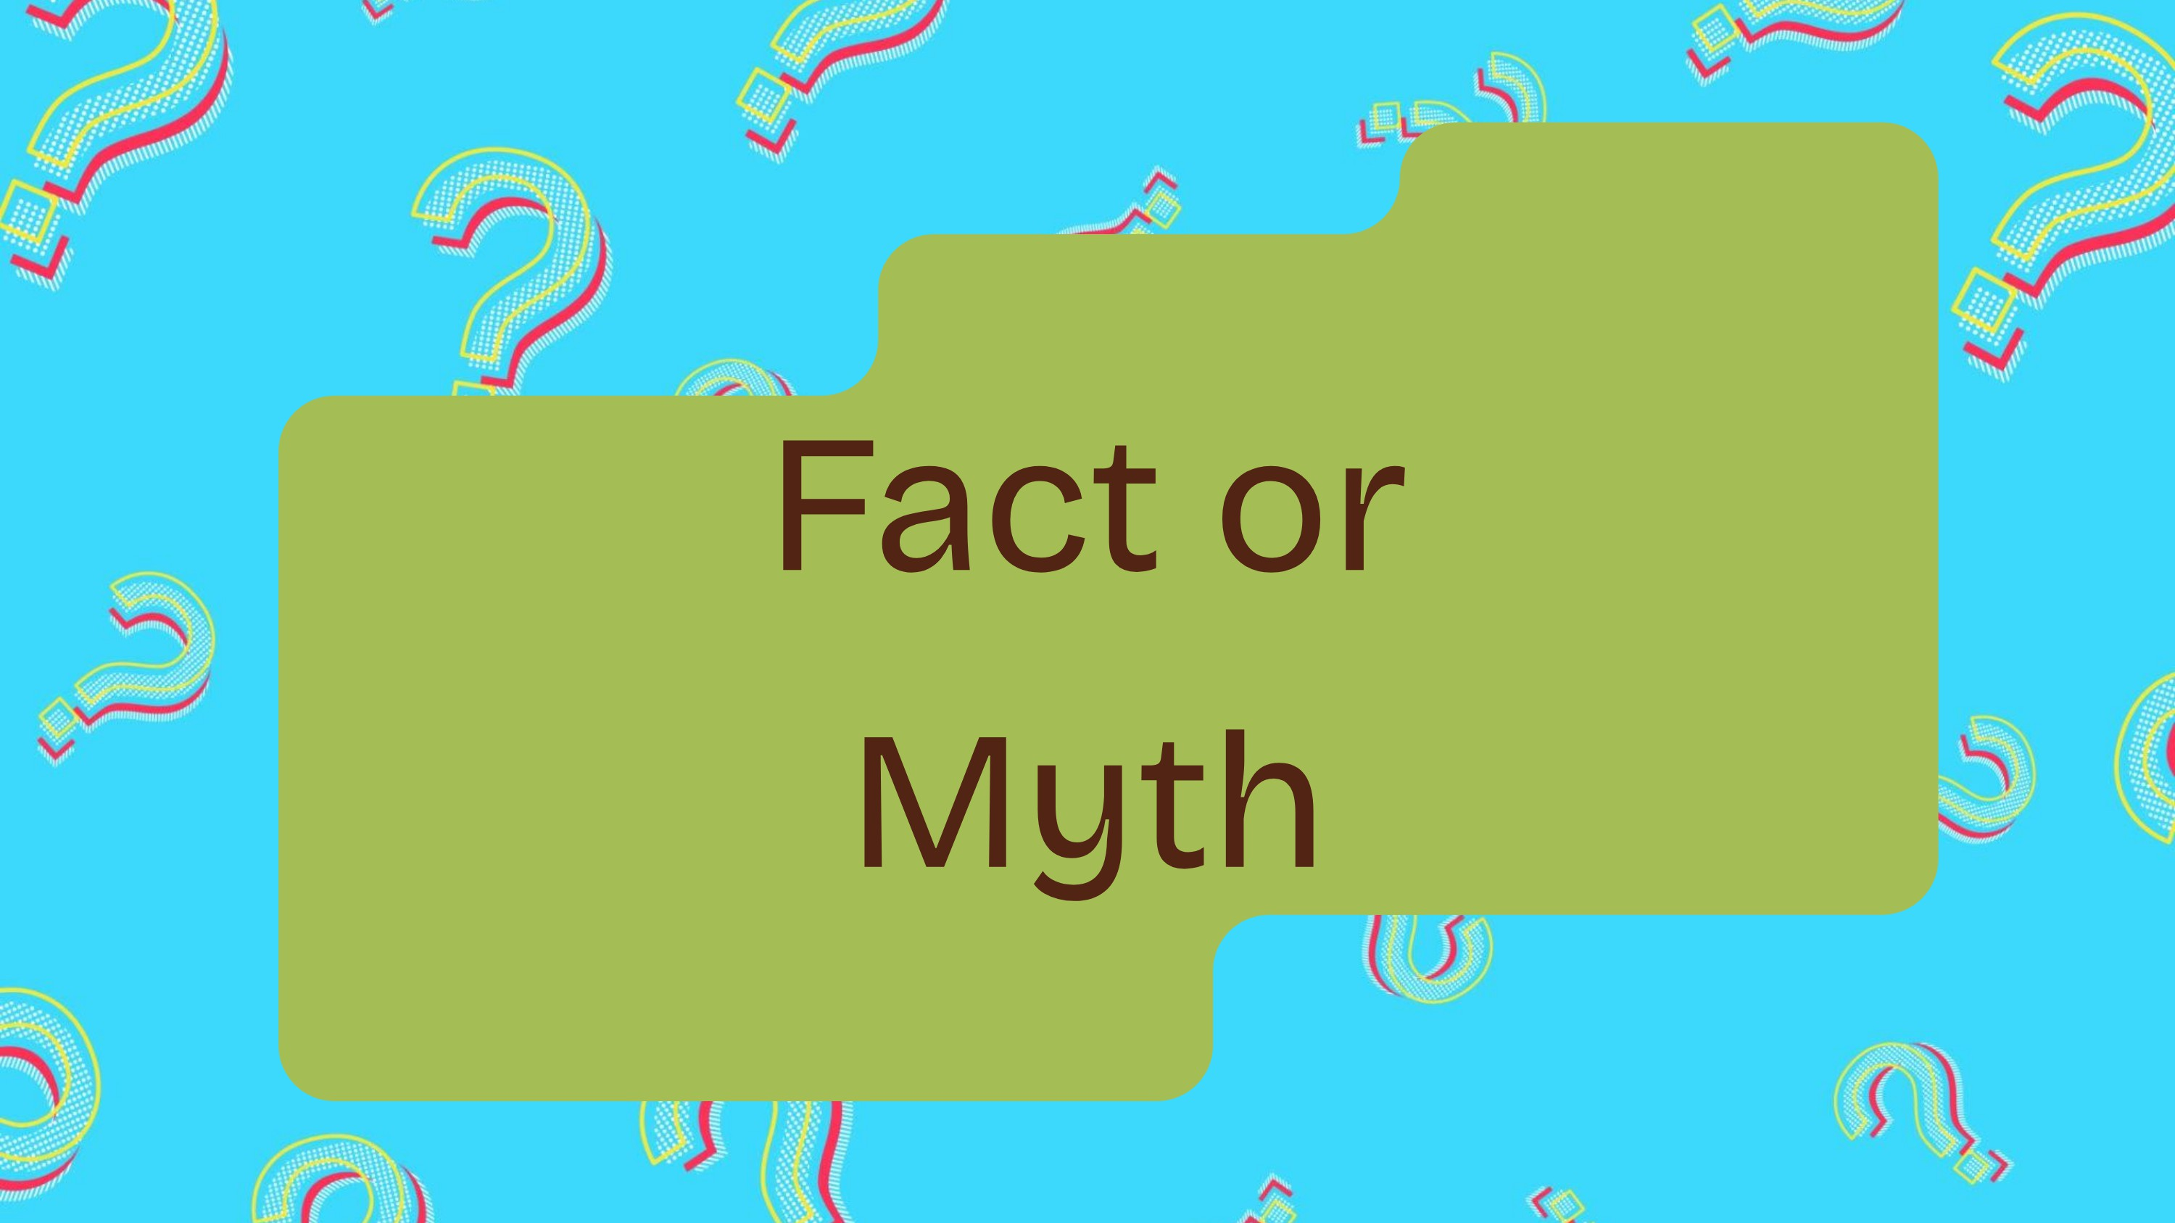

Slide 6

Exercise can replace therapy or medication for mental illness.

Slide 7

Exercise will always make you feel happy and euphoric.

Slide 8
act
Exercise can help reduce anxiety.

Slide 9
You must do
high-intensity workouts to get mental health benefits.

Slide 10


act
Physical activity can increase confidence, body image satisfaction, and feelings of accomplishment.

Slide 11
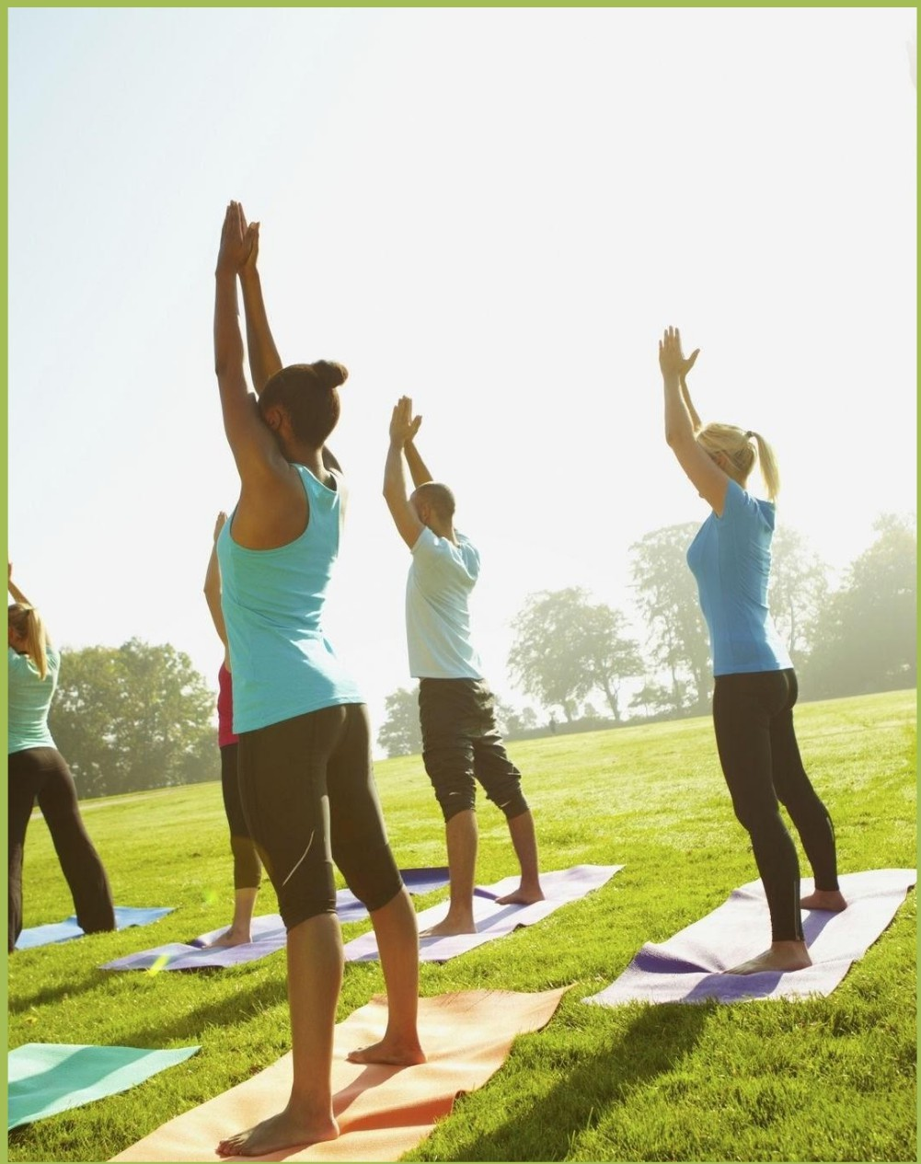
What is Physical
Activity
"Any bodily movement produced by skeletal
muscles that requires energy"
•
Walking to the corner shop
•
Vacuuming
•
Gardening
•
Carrying heavy groceries

Slide 12
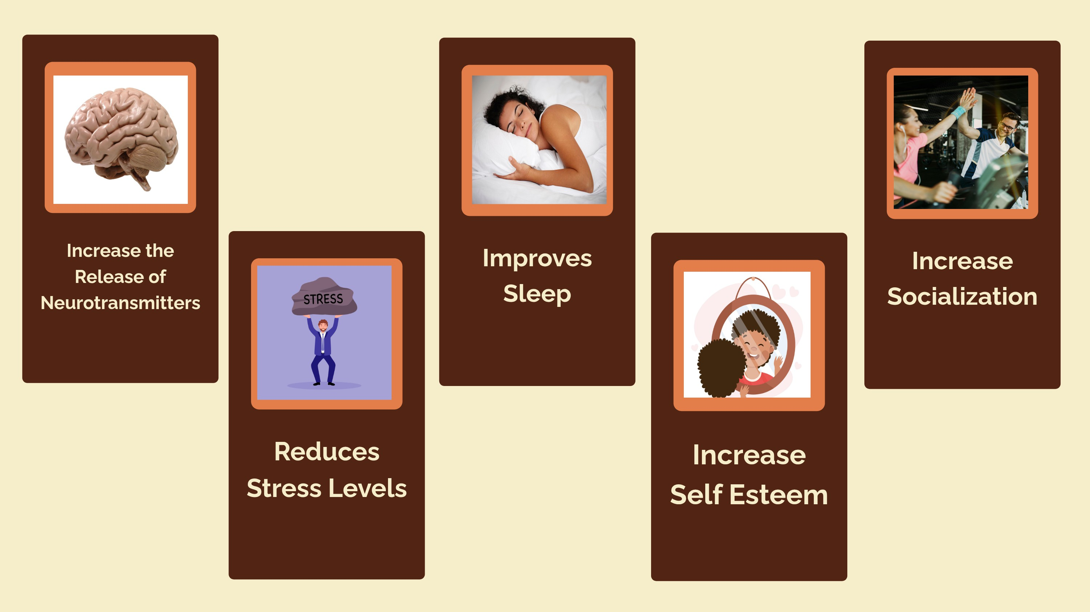

Slide 13
Release of Neurotransmitters
r
Dopamine
Endorphins
Serotonin
(Jayeshkumar Kanani et al., 2025)

Slide 14




Endorphins
hormones in the body that helps block pain, reduces stress and increase overall wellbeing
(Cleveland Clinic, 2022)

Slide 15
Release of Neurotransmitters
r
Dopamine
Endorphins
Serotonin
(Jayeshkumar Kanani et al., 2025)

Slide 16




Dopamine
acts as a messenger between the brain and nerves and the rest of the body, it is our bodies reward system as it is released during times of pleasure that increases our motivation to complete those actions
(Cleveland Cliic, 2022)

Slide 17
Release of Neurotransmitters
r
Dopamine
Endorphins
Serotonin
(Jayeshkumar Kanani et al., 2025)

Slide 18
Serotonin
The messenger between your central nervous system in your peripheral nervous system, is in charge of telling your body how to work. serotonin influences a person·s learning, memory, happiness, body temperature regulations sleep sexual behavior and hunger.
(Cleveland Clinic, 2022)

Slide 19


Slide 20












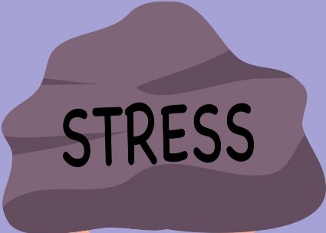
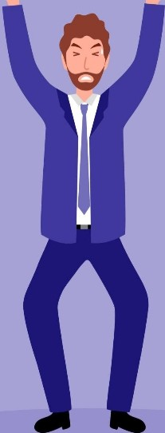
•
Physical activity increases the production of endorphins, the feel-good neurotransmitter and decrease the body's reaction to stress.
(Cleveland Clinic, 2022)

Slide 21

•
 | Key Benefits:
• | Boosts mood | •
• | reduces pain
e | Reducesthe
 | fight-or-flight | •
 | response | •
Supports heart, blood vessel, and immune
system
Lowers resting heart rate
and blood pressure Maintain energy
(Cleveland Clinic, 2022)

Slide 23









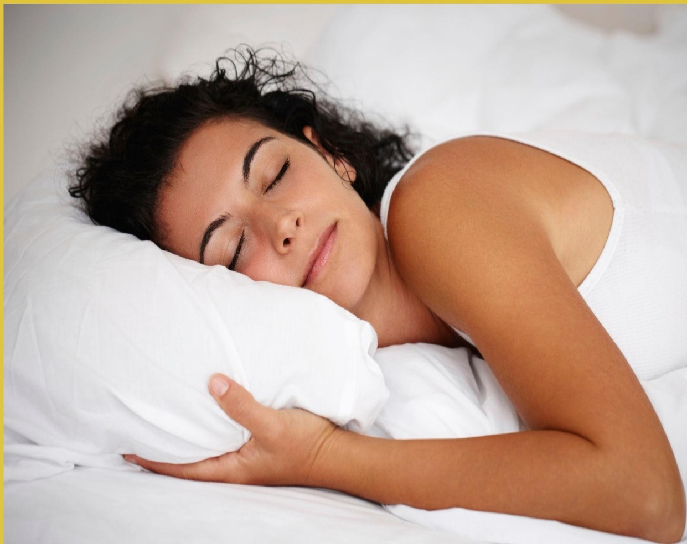
Moderate physical activity improves sleep by helping you fall asleep faster, sleep longer, and
wake up less often during the night.
,
,ti
(Alnawwar et. al, 2023)

Slide 25
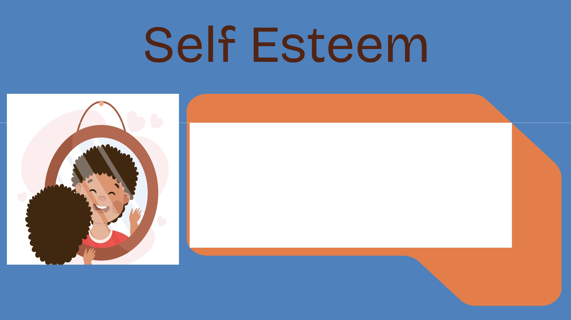
Boosts self-esteem and confidence
Builds resilience and coping skills
Strengthens social connections

Slide 27
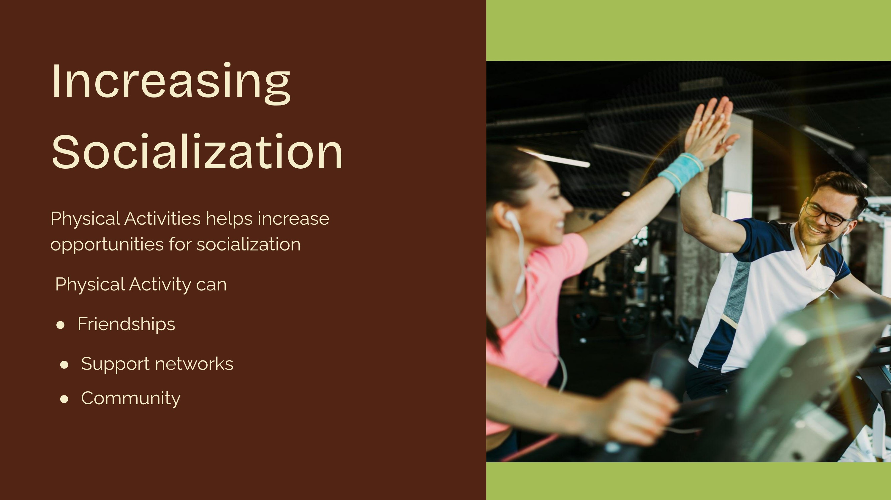

Slide 28

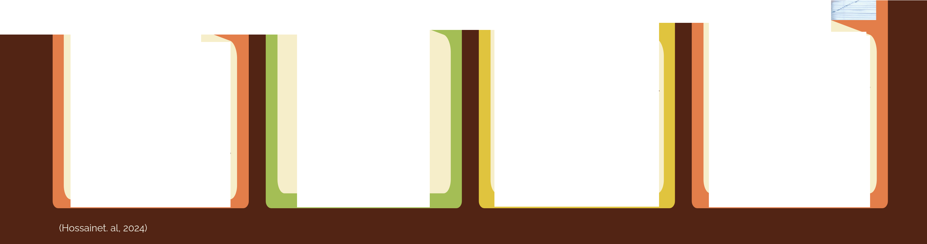
-
Aerobic Exercise
Resistance Training
uses weights or resistance bands to encourage muscle development
Yoga
mind-body practice that combines physical posture, breathing exercises, and meditation
Mindfulness-based Exercises
tai chi or qigong involve slow, deliberate movements and focus on breathing and body awareness
any form of activity that increases the heart rate and breathing

Slide 29





o a s
•
Specific: Measurable:
Achievable/Attainable: Relevant:
Time-bound:

Slide 30

I will walk for 30 minutes, 4 days a
week for the next 2 months to improve my physical fitness.

Slide 31

I will practice deep breathing for
10 minutes very night for the next .5Q days to reduce stress.

Slide 32

I will attend a 20-minute yoga session
� times a week for the next month to support my emotional well-being.

Slide 33



Station 1:
Strength Training
Station 2:
Aerobic Exercises
Station 3: Yoga
Station 4: Tai Chi
Station 5: Smart Goal

Slide 34
How can Occupational and
Physical Therapy help
OT and PT can NOT treat mental health but we can help with underlying conditions that make physical activities hard.
Strength
Mobility
Endurance
Functional movement
Anytime you are experiencing limitations to your normal activities it's best to
reach out to your physician to ask for a referral for occupational or physical therapy.

Slide 35

Exercise reduces depression levels by increasing neurotransmitters, decreasing stress, increase sleep quality, and increase self esteem.
Summary
There are various types of exercise that can be beneficial to all types of people and their abilities.
Using Smart goals is a great way to initiate exercising to help with mental health.
If someone is experiencing limitations to their normal activities, occupational and physical therapy can help.

Slide 36




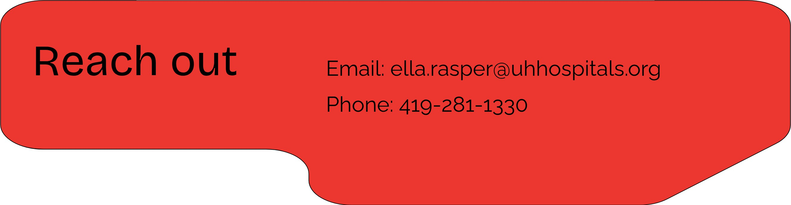
n1vers1
■ ■
■
OS I a S

Slide 37
Cites
Alnawwar, M.A., Alraddadi, M. I., Algethmi, R. A., Salem, G. A., Salem, M.A., & Alharbi, A. A. (2023). The Effect of Physical Activity on Sleep Quality and Sleep Disorder: A Systematic Review. Cureus, 15(8), e43595. https://doi.org/10.7759/cureus.43595Cleveland Clinic. (2022, March 23). Dopamine: What it is, function & symptoms. https://my.clevelandclinic.org/health/articles/22581-dopamine
Cleveland Clinic. (2022, May 19). Endorphins: What they are and how to boost them.https://my.clevelandclinic.org/health/body/23040-endorphins Cleveland Clinic. (2022, March 18). Serotonin: What it is, function & levels. https://my.clevelandclinic.org/health/articles/22572-serotonin
Hossain, M. N., Lee, J., Choi, H., Kwak, Y. S., & Kim, J. (2024). The impact of exercise on depression: how moving makes your brain and body feel better. Physical activity and nutrition, 28(2), 43-51. https://doi.org/10.20463/pan.2024.0015
Jayeshkumar Kanani, Shraddha Baldania, Dyana Nasif (2025), Integrating Physical Therapy and Exercise in Mental Health: A Novel Framework for Suicide Prevention and Depression Management, J. Neuroscience and Neurological Surgery, 17(2): DOl:10.31579/2578-8868/359
Marques, A., Marconcin, P., Werneck, A. 0., Ferrari, G., Gouveia, E. R., Kliegel, M., Peralta, M., & Ihle, A. (2021). Bidirectional Association between Physical Activity and Dopamine Across Adulthood-A Systematic Review. Brain sciences, 11(7), 829. https://doi.org/10.3390/brainsci11070829
Mayo Clinic. (2022, August 3). Exercise and stress: Get moving to manage
stress.https://www.mayoclinic.org/healthy-lifestyle/stress-managemenUin-depth/exercise-and-stress/art-20044469
Murphy, J., McGrane, B., White, R. L., & Sweeney, M. R. (2022). Self-Esteem, Meaningful Experiences and the Rocky Road-Contexts of Physical Activity That Impact Mental Health in Adolescents. lnternationaljournalof environmental research and public health, 19(23), 15846. https://doi.org/10.3390/ijerph192315846

