Slide 1
Rest to Be Your Best: Optimizing Sleep for Work-Life Balance Because a good night’s sleep is cheaper than therapy—and way more effective than coffee! Hunter Edwards, M.A, LPC

Slide 2




Slide 3
Today’s Takeaways
Learn how sleep influences daily performance, cognitive functioning, and overall well-being.
Identify and implement at least one evidence-based strategy to improve sleep quality and support consistent, healthy sleep habits.
Think about your typical night—how does the quality of your sleep show up in your focus, mood, or productivity the next day?

Slide 4
Popular Sleep Myths
“I only need 4–5 hours of sleep and I’m fine.”
“If you can’t sleep, just stay in bed and keep trying.”
“Watching TV or scrolling my phone helps me wind down.”
“Alcohol helps me sleep better.”
Which of these sleep myths have you believed or practiced at some point, and how did it affect you?

Slide 5

Why does sleep Matter?
Sleep is the foundation for work-life balance!
Improves focus and productivity
Supports emotional regulation
Boosts physical and mental health
Strengthens decision making
Helps maintain healthy relationships

Slide 6
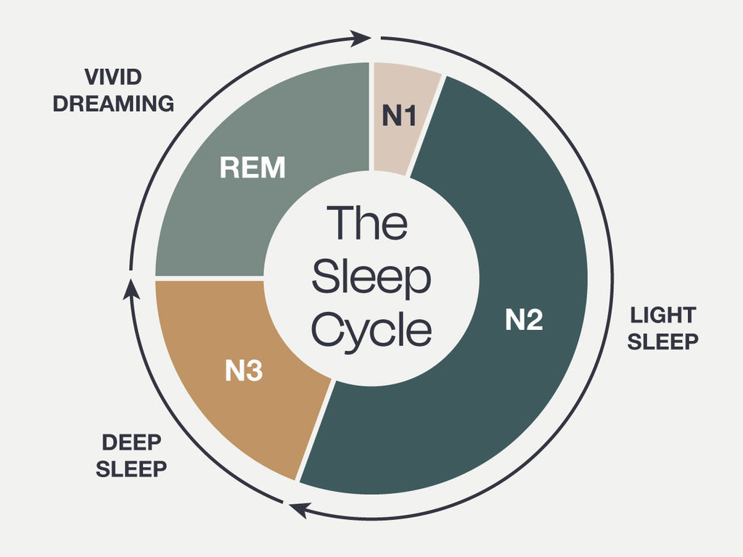
The Science of Sleep
REM vs NREM sleep (4 total stages)
Stage 1- 5% of total sleep
Stage 2- 45-55% of total sleep
Stage 3- 15-25% of total sleep
REM- 20-25% of total sleep
Sleep happens in cycles with each lasting roughly 90-120 minutes
Most individuals go through 4 to 5 sleep cycles per night (8 hours of sleep)
Adults are recommended to get 7 to 9 hours of quality sleep per night
(AKBC, 2023)

Slide 7
What Happens During Sleep “Sleep is your body’s nightly checklist: fix things, file memories, steady emotions, and don’t freak out about yesterday."
Memory organization and consolidation
Physical restoration: repairing tissues, building muscle, and strengthening the immune system
Emotional regulation
Stress recovery
Memory integration—especially complex learning
Processing traumatic or emotionally charged experiences

Slide 8
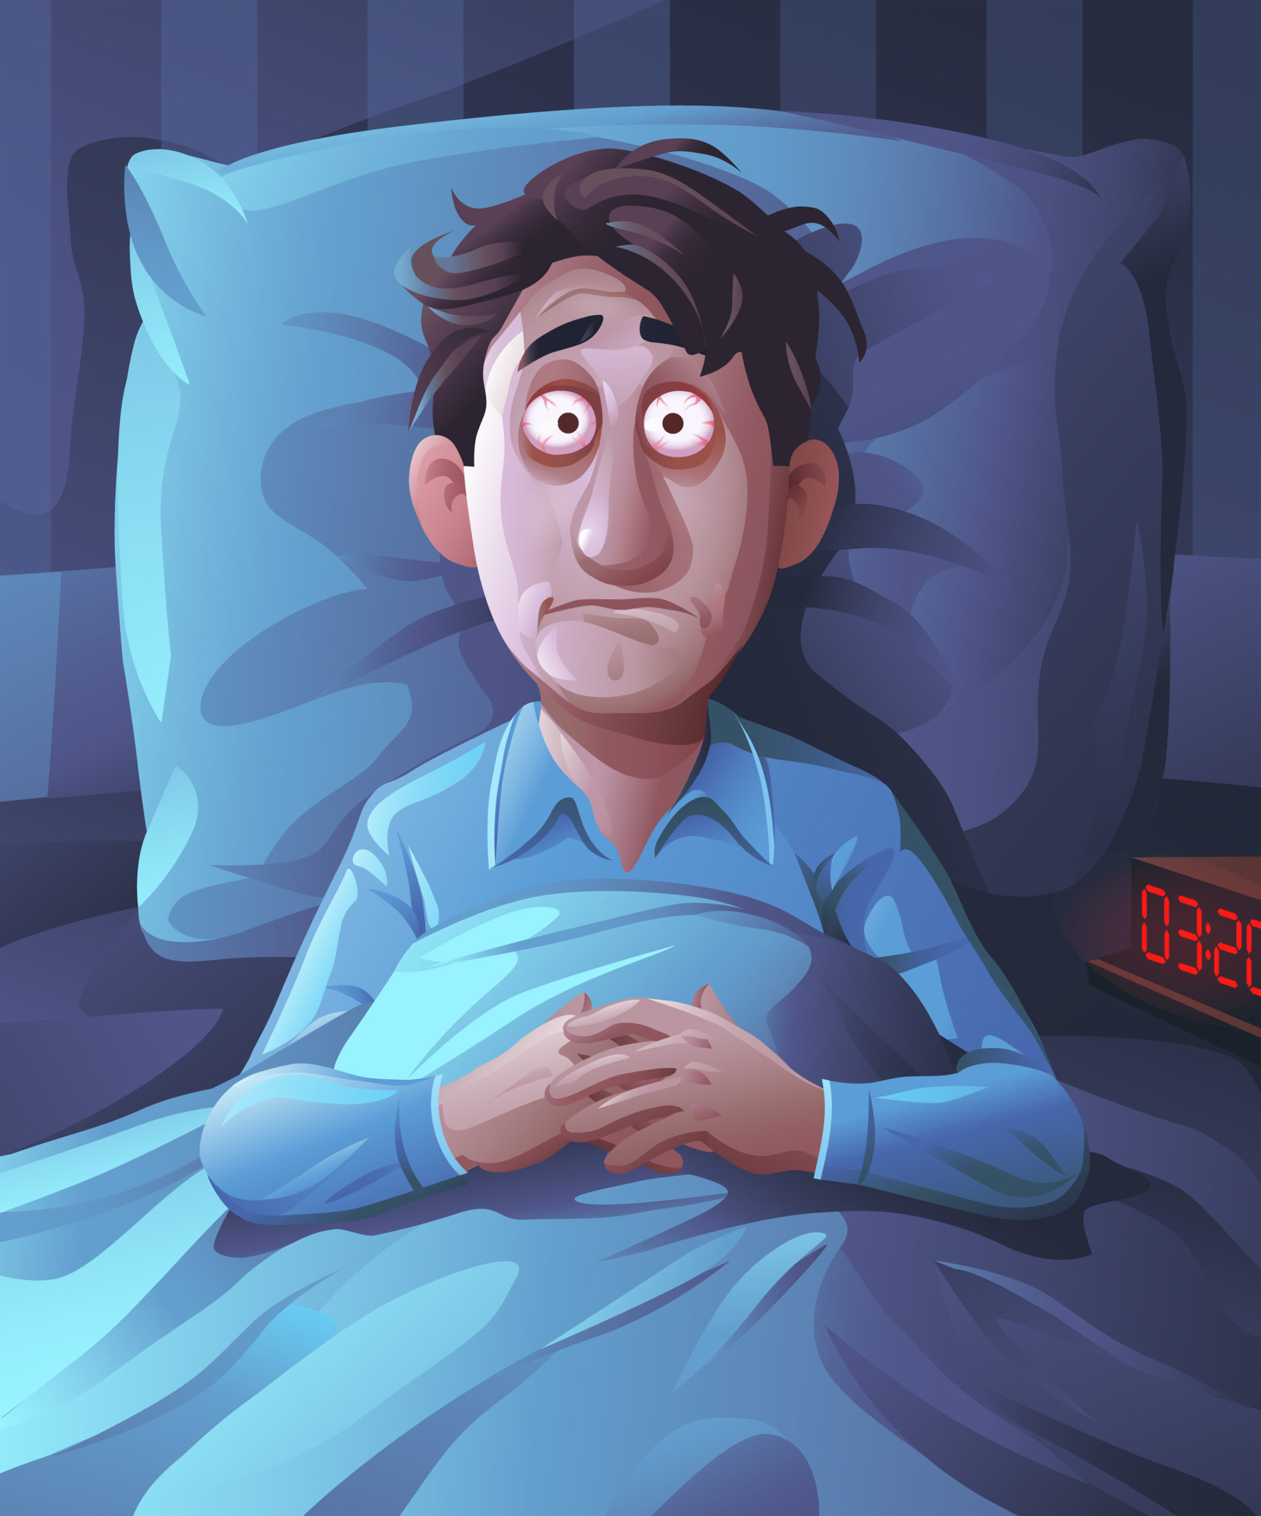
Common Disruptors of Sleep
Screen time/ Blue Light exposure
Suppresses melatonin and delays circadian rhythms
Irregular sleep schedules
Disrupts circadian rhythm
Stress and Anxiety
Release of cortisol
Increased heart rate
Staying alert
Alcohol use before bed
Suppresses REM sleep
Fragments sleep cycles
Poor sleep environment
Noise, lighting, temperature
Late night eating
Disrupts circadian rhythm
Interferes with metabolic processes
Think of a recent night when you had difficulty sleeping—what factors do you believe may have contributed to that experience?

Slide 9
Side effects of Poor Sleep
Reduces emotional regulation
Weakens the brain’s ability to manage emotions, leading to irritability and mood swings
Increases stress reactivity
Sleep deprivation elevates cortisol and amplifies emotional responses to stress
Impairs decision-making and judgment
Affects the prefrontal cortex, reducing rational thinking and increasing risk-taking
Strains relationships and communication
Poor sleep is linked to increased conflict, reduced empathy, and poorer communication in relationships
Decreases attention and concentration
Lack of sleep reduces focus, increasing errors and difficulty completing tasks
Reduces motivation and engagement at home and work
Sleep deprivation lowers energy and drive, leading to disengagement from responsibilities

Slide 10
Real life scenarios
“After a poor night’s sleep, a small inconvenience at work (like a minor email issue) feels overwhelming and stressful.”
“You find yourself snapping at a coworker or family member over something you normally wouldn’t react strongly to.”
“A simple conversation with a partner turns into an argument because you’re more irritable and less patient.”
“You skip exercise, chores, or important tasks because you feel too drained to follow through.”
How might your sleep habits be influencing your interactions with others at work or at home?

Slide 11
Quality sleep: a better version of you!
Focus
Quality sleep improves attention span and the ability to concentrate on tasks without distraction.
It enhances memory and information processing, making it easier to learn and retain new material.
Emotional Stability
Adequate sleep helps regulate mood and reduces irritability and emotional reactivity.
It strengthens the brain’s ability to manage stress and respond calmly to challenges.

Slide 12
Quality sleep: a better version of you!
Productivity
Well-rested individuals work more efficiently, complete tasks faster, and make fewer errors.
Sleep supports better decision-making, problem-solving, and creativity in daily tasks.
Overall Well-Being
Quality sleep supports physical health, including immune function and energy levels.
It contributes to a more balanced lifestyle, improving motivation, relationships, and overall life satisfaction.

Slide 13
Considerations for better sleep
Routine
Go to bed and wake up at the same time every day (even on weekends).
Pre-sleep wind-down: reading, light stretching, meditation.
Avoid screens 30–60 minutes before bed.
“Your brain needs a bedtime routine like your dog needs a walk—skip it and things get messy.”
Environment
Keep the bedroom cool, dark, and quiet.
Limit blue light exposure.
Use blackout curtains or eye masks.
Reserve the bed for sleep and intimacy only—don’t turn it into a home office.
“Your bedroom should feel like a cave, not Times Square.”

Slide 14
Considerations for better sleep
Diet
Avoid caffeine and alcohol close to bedtime.
Light snacks are okay; heavy meals are not.
Hydration: don’t overdo it before bed (midnight bathroom trips ruin deep sleep).
Exercise
Regular physical activity improves sleep quality.
Best timing: morning or afternoon; avoid intense workouts right before bed.
Stress
Stress = enemy of sleep.
Techniques: journaling, mindfulness, breathing exercises
Avoid doom-scrolling or work emails before bed.

Slide 15
Practical tips
White Noise Machines
White noise masks disruptive sounds (traffic, neighbors) and creates a consistent auditory environment.
Cool Room
A cooler environment (around 65°F ) supports the body’s natural decrease in temperature during sleep.
Blackout Curtains
Darkness signals melatonin production, the hormone that regulates sleep.
Fan
Fans circulate air, maintain a cool temperature, and provide gentle white noise.
Warm Showers
Warm water raises body temperature slightly; after the shower, the cooling effect signals the body to prepare for sleep.
If you can't fall asleep within 20 minutes, get out of bed and do something relaxing (avoid blue light)
What are some other practical tips that you have found to be helpful?

Slide 16
When to seek professional help
Persistent insomnia
Difficult falling asleep multiple times a week for 3 months
Mental Health Concerns
Sleep disruptions might be caused by anxiety, depression, or trauma
Nightmares
Dependence on substances
Physical Conditions
Chronic pain, difficulty breathing, or other medical conditions
Medication side effects
Excessive daytime sleepiness

Slide 17
Any Questions?

Slide 18
References
Alaska King Beds. (2023, June 13). What does the sleep cycle look like: Overview of the different stages of sleep. https://alaskankingbeds.com/blogs/bedtime-reading/what-does-the-sleep-cycle-look-like-overview-of-the-different-stages-of-sleep
Alhola, P., & Polo-Kantola, P. (2007). Sleep deprivation: Impact on cognitive performance. Neuropsychiatric Disease and Treatment, 3(5), 553–567.
Banks, S., & Dinges, D. F. (2007). Behavioral and physiological consequences of sleep restriction. Journal of Clinical Sleep Medicine, 3(5), 519–528.
Buysse, D. J. (2014). Sleep health: Can we define it? Does it matter? Sleep, 37(1), 9–17. https://doi.org/10.5665/sleep.3298
Hafner, M., Stepanek, M., Taylor, J., Troxel, W. M., & Van Stolk, C. (2017). Why sleep matters—The economic costs of insufficient sleep. RAND Health Quarterly, 6(4), 11.
Killgore, W. D. S. (2010). Effects of sleep deprivation on cognition. Progress in Brain Research, 185, 105–129. https://doi.org/10.1016/B978-0-444-53702-7.00007-5
Lowe, C. J., Safati, A., & Hall, P. A. (2017). The neurocognitive consequences of sleep restriction: A meta-analytic review. Neuroscience & Biobehavioral Reviews, 80, 586–604. https://doi.org/10.1016/j.neubiorev.2017.07.010
Medic, G., Wille, M., & Hemels, M. E. H. (2017). Short- and long-term health consequences of sleep disruption. Nature and Science of Sleep, 9, 151–161. https://doi.org/10.2147/NSS.S134864
Palmer, C. A., & Alfano, C. A. (2017). Sleep and emotion regulation: An organizing, integrative review. Sleep Medicine Reviews, 31, 6–16. https://doi.org/10.1016/j.smrv.2015.12.006
Walker, M. P. (2017). Why we sleep: Unlocking the power of sleep and dreams. Scribner.
Watson, N. F., Badr, M. S., Belenky, G., et al. (2015). Recommended amount of sleep for a healthy adult: A joint consensus statement. Sleep, 38(6), 843–844. https://doi.org/10.5665/sleep.4716

